Slide 1



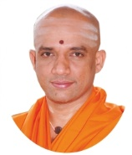
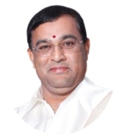


|| Jai Sri Gurudev ||
Sri Adichunchanagiri Shikshana Trust®
SJB INSTITUTE OF TECHNOLOGY
Department of Electronics & Communication Engineering
Review-2 – Major-Project (18ECP78) Presentation on
Wireless Acoustic Data and Image Transmission Over Handheld Transreciever (W.A.D.I.T.O.H.T)
Batch 3
Presented By
Md. Ashfaq 1JB19EC053
Md. Atheeq Zamani 1JB19EC054
Nivendu Tripathy 1JB19EC063
Dinanshu Biswas 1JB19EC026
Under the guidance of
Mrs. Supriya M.
Assistant Professor
Dept. of ECE, SJBIT

Slide 2
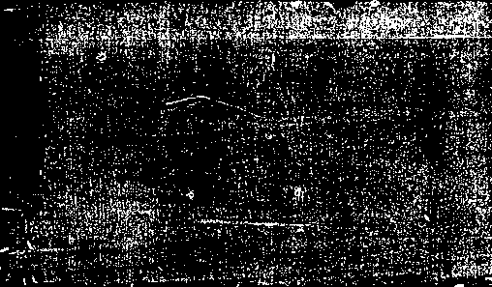


CONTENTS
1.Abstract
2.Introduction
3.Literature Survey
4.Motivation and Challenges
5.Problem Statement
6.Objectives
7.Proposed Methodology
8.Expected Outcome
9.Applications
11.References
10.Project Timeline

Slide 3

Keywords
Ubiquitous Signal,Sonic Barcode, Handheld Transreciever, Hydrophones, Automatic Packet Reporting System
Acoustic Communication,Ubiquitous computing, slow scan television

Slide 4

ABSTRACT
In this project we first enable the conversion of image data to sound using pseudo Hilbert curve on python, and perform sampling, quantizing, and parity check bits ordering to get the original image back.
In the next section,a methodology is proposed using sound as a carrier wave with a changing band frequencies depending on the type of data transmitted
Then we deal with transmission of text using frequency encoding of ascii values , audio using conventional techniques and image on a sound using air and water as the medium
In addition, we see the real time applications of from military to payments to crowd control

Slide 5
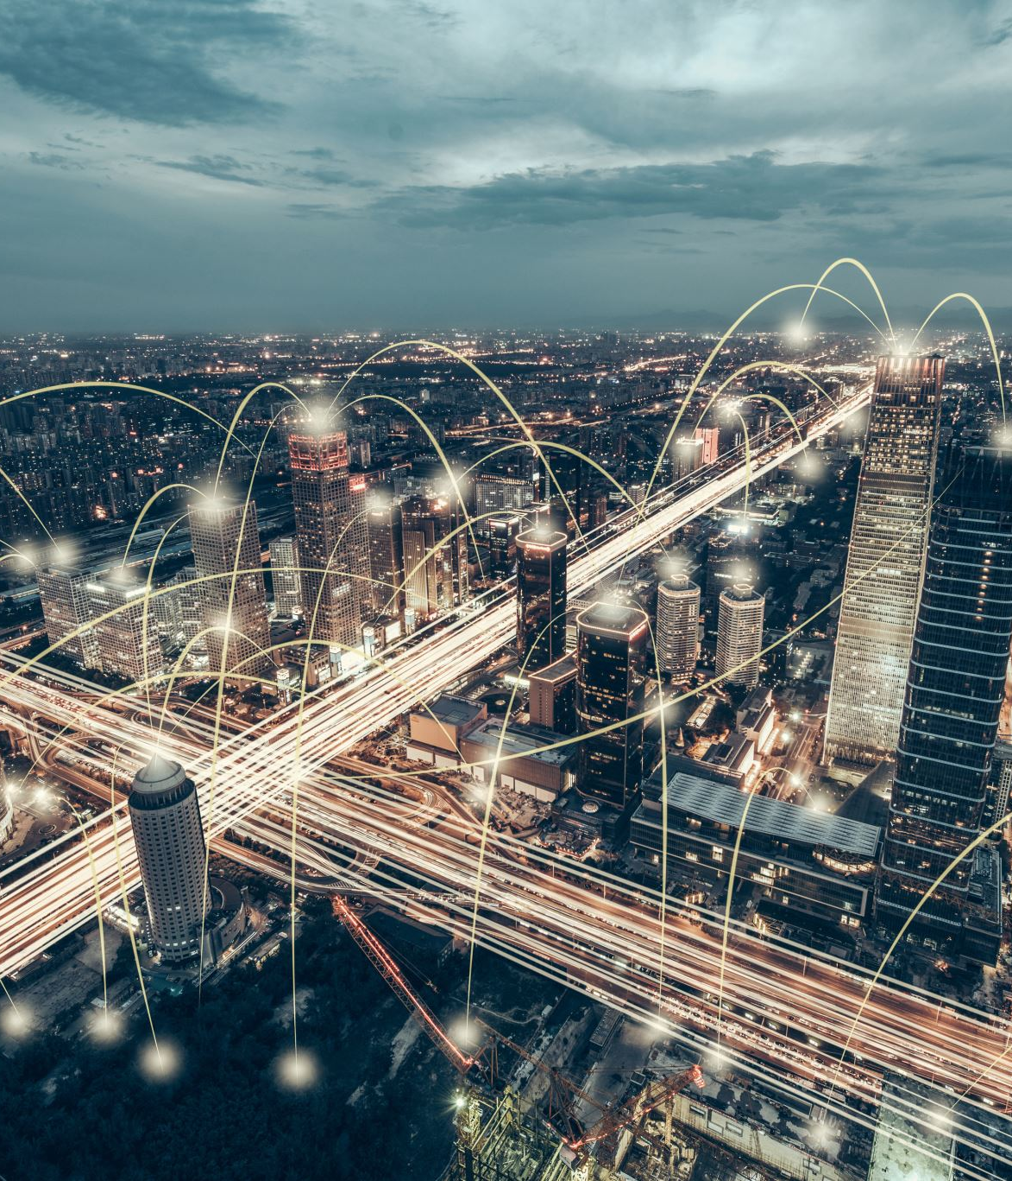
INTRODUCTION
The digital divide between urban and rural areas is now attracting active research. There are a host of reasons for this divide and this presents the work in progress about one proposed solution to a major technical problem causing this.
It has been noted that the high frequency WiFi and similar signals are not well suited for the wilderness type of environment with dense foliage.
Additionally, such terrains also impose stringent restriction on computational and electric power as well as in cost.
This calls forth the need for a new type of signal that can work efficiently in such environments and a low cost, low bandwidth, low frequency signal that can possibly work is identified in the form of Sound.
There are very clear and practical affordances of data over sound. From its seamless integration into existing hardware and frictionless connections, to its ability to work offline in even the most extreme environments, there's myriad potential use cases for data-over-sound.

Slide 6
We try to propose a new network architecture that is devoid of pairing, connecting like Bluetooth, wifi etc and is designed to work with the low frequency, ubiquitous signals such as sound. The architecture can work in peer-to-peer ad-hoc networks mode, infrastructure mode, broadcast mode (for remote telemetry) etc. using wideband multi-channel transmission The rural environment does not have these financial resources, and with some added technological limitations that makes it almost impossible to adopt the urban technologies leaves this front struggling to establish basic minimal connectivity. The terrain and sparse user base of the jungle type of environment makes it extremely ineffective to set up wired infrastructure for network connectivity and hence the better option in terms of cost effectiveness and reach is using wireless. However, the dense growth of bushes drastically reduces the range of high frequency RF signals used by WiFi, 3G etc. These are also high energy signals, greatly depreciating the usability as the terrains pose serious limitations to the rages of these signals. It is therefore desirous to have a low energy, low frequency, ubiquitous signal. High volumes of data can be communicated through data transmission systems such as a local or wide area network (for example, the Internet), a terrestrial communication system or a satellite communication system. These systems require complicated hardware and/or software and are designed for high data rates and/or long transmission ranges. For transfers of data at close proximity or short distances, such as between a personal computer and personal data assistants (PDAs), the systems above may be an inconvenient communication medium for users because of the complexity, delay and often the cost involved in accessing the systems. The ubiquity of sound also leaves us open to handle a lot of “noise” as well. The previous studies have analyzed and proven that sound can be used as a carrier signal for wireless data communication, studied the noise profiles in various environment to gather idea on efficient signal-to-noise ratios and to aid identification of appropriate channels for communication, and a survey to identify sound perception of various frequencies by humans so that the channel used for data transmission causes minimal intrusion to the environment of use. Our architecture proposes signal (sound), as a technology to send data and have made it easier and faster to share and/or transfer information.

Slide 7

Literature survey
Sl. No. | Author | Title | Year | Inference
1. | Dr Daniel Jones | Chirping Communication – Sending Data Over Sound | October 8, 2017 | Designing a sound based networking infrastructure, to provide an alternative to wireless RF comms protocol
2. | Dr. Hamada Esmaiel ,Junfeng Wang, Naveed Ur Rehman and Zeyad A. H. Qasem | Underwater Image Transmission Using Spatial Modulation Unequal Error Protection for Internet of Underwater Things | October 2, 2019 | Providing an algorithm for encoded image classification and performing the next generation of the underwater acoustic communication techniques that would be focused on improving transmission data rate to support real-time underwater multimedia applications
3. | Kuruvilla Mathew, Biju Issac and Tan Chong | Ubiquitous Text Transfer Using Sound a Zero-Infrastructure Alternative for Simple Text Communication | 2014 | The paper discusses the successful transfer of text data between smart devices using sound as the signal, making use of the built in speaker and microphones as the ubiquitous hardware. The experiment created two Smartphone apps. a sender and a receiver, encoded the data using frequency encoding of ASCII value of each character with a frequency space between each subsequent value.
4.
5.
6.
7.

Slide 8
Literature survey
pril | Author | Title | Year | Inference
4. | Vanu Bose, Michael Ismert, Matt Welborn, and John Guttag | Virtual Radios | April 4, 1999 | Conventional software radios take advantage of vastly improved analog to digital converters (ADC’s) and digital signal processing (DSP) hardware. This paper approaches, with what they refer to as virtual radios, rather than use DSP’s, they have chosen to ride the curve of rapidly improving workstation hardware. Use of wideband digitization and then perform all of the digital signal processing in user space on a general purpose workstation. This approach provides new way to signal processing that exploit the hardware and software resources of the workstation.
5. | James Schueckler | A digital image processing system for slow scan television | May 9, 1981 | This paper describes a low cost, but powerful, digital image processing system. Although general purpose, it was designed for experimentation with amateur radio slow scan television (SSTV)
6. | Brian G. Ferguson | Acoustic signal processing for enhanced situational awareness during military operations on land and under the sea | 2014 | The paper discusses the military underwatwer applications of ASP.
4.
5.
6.
7.

Slide 9
Motivation
Communication systems have been developed using communication medium such as radio frequency (RF) or Infrared (IR) to transmit data. However, these systems require specialized communication hardware and/or interfaces, which can often be expensive and/or impractical to implement.
It has been noted that the high frequency WiFi and similar signals are not well suited for the wilderness type of environment with dense folia.
Underwater communication is still a big challenge due to the oceanic environment physical characteristics.
The project has an immense potential in military applications from data communication(text, audio , image, video) without internet to industrial production setups to sensing of foreign aliens.

Slide 10
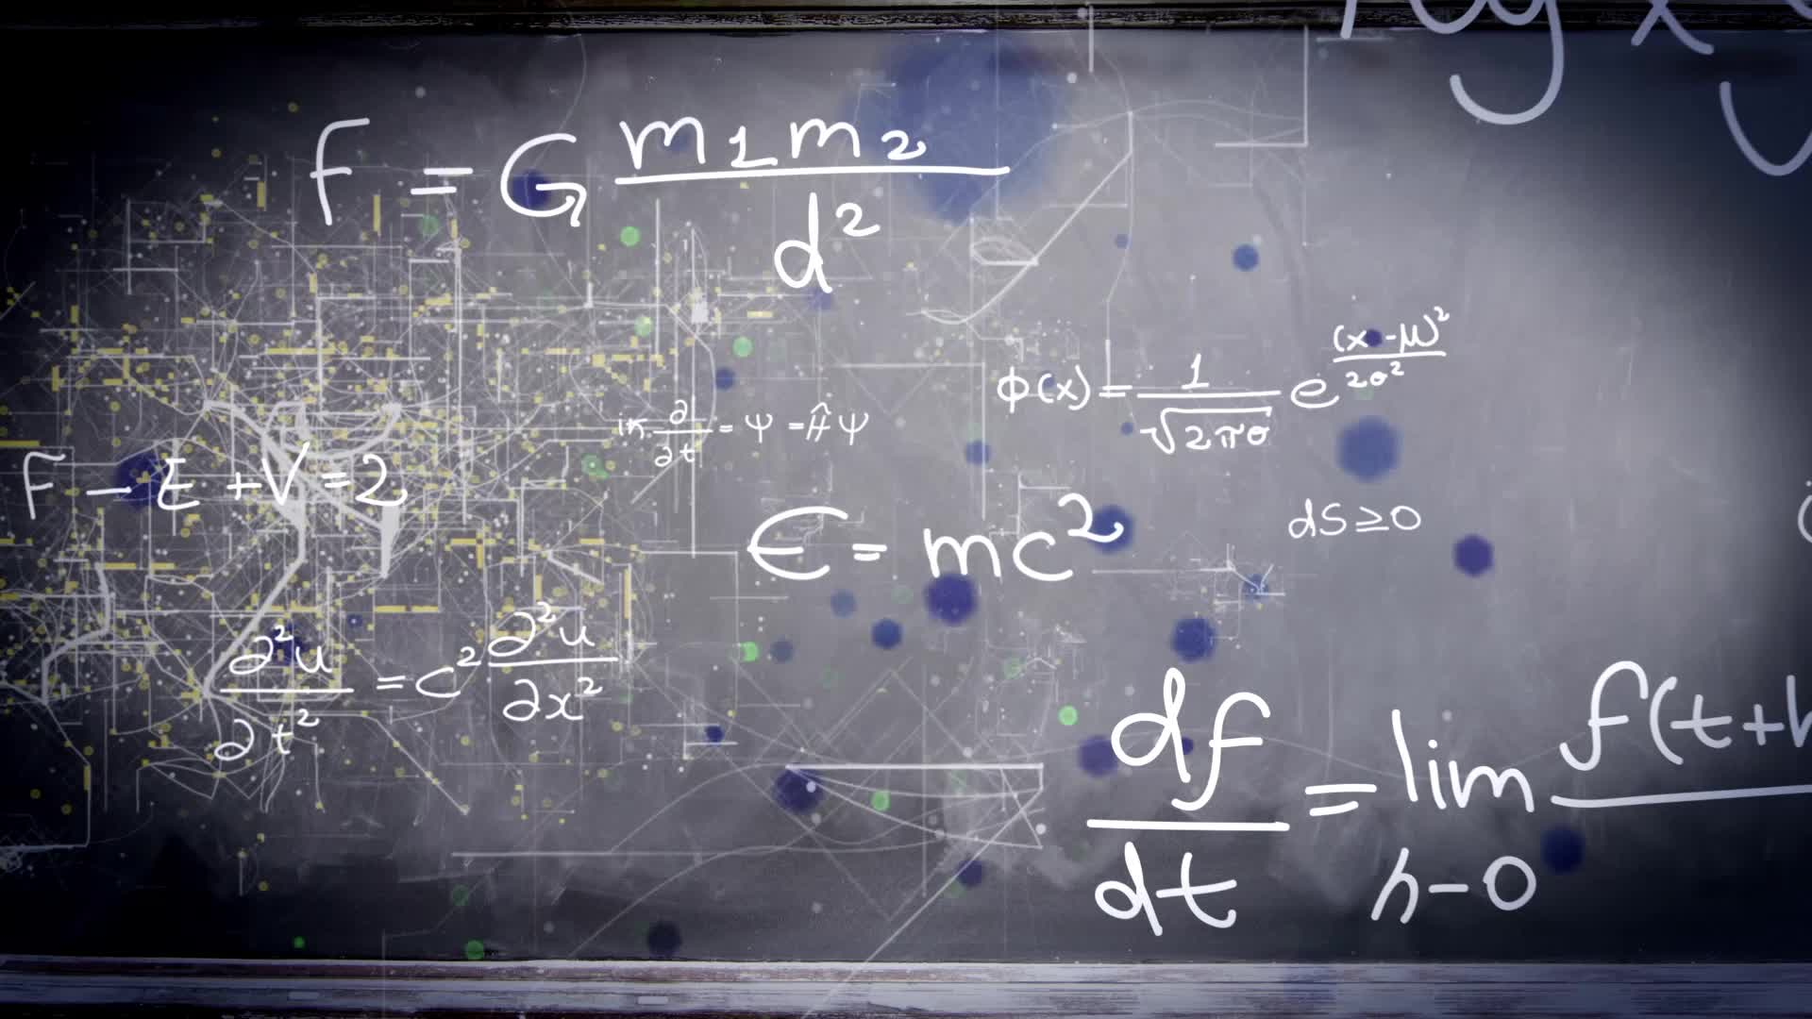
Challenges
Difficult to transmit sound over large distances.
Degradation and dampening of sound with terrain change.
Only 64x64 px image can be converted to sound, any higher or lower it creates interference with intended application.
Conversion of image and video data is taking 10 -30min.

Slide 11
PROBLEM STATEMENT
Images, text and audio are transmitted on sound waves in wireless comms architecture.
Images are converted to sound and make them non detectable to sensors.
Network sniffing and packet tracing is not detected in the case of sound waves , to ensure a secure transmission of data .

Slide 12

OBJECTIVES
To convert the images to sound and vice versa.
To encode, encrypt and emit the data (text, audio, image, video) over handheld trans-recievers

Slide 13
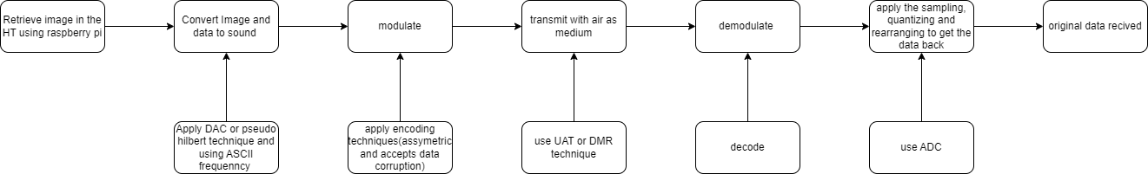
Proposed Methodology

Slide 14
Expected outcome
.
Images, text and audio are transmitted on sound waves in wireless comms architecture.
Images are converted to sound and make them non detectable to sensors.
Network sniffing and packet tracing is not detected in the case of sound waves , to ensure a secure transmission of data .

Slide 15
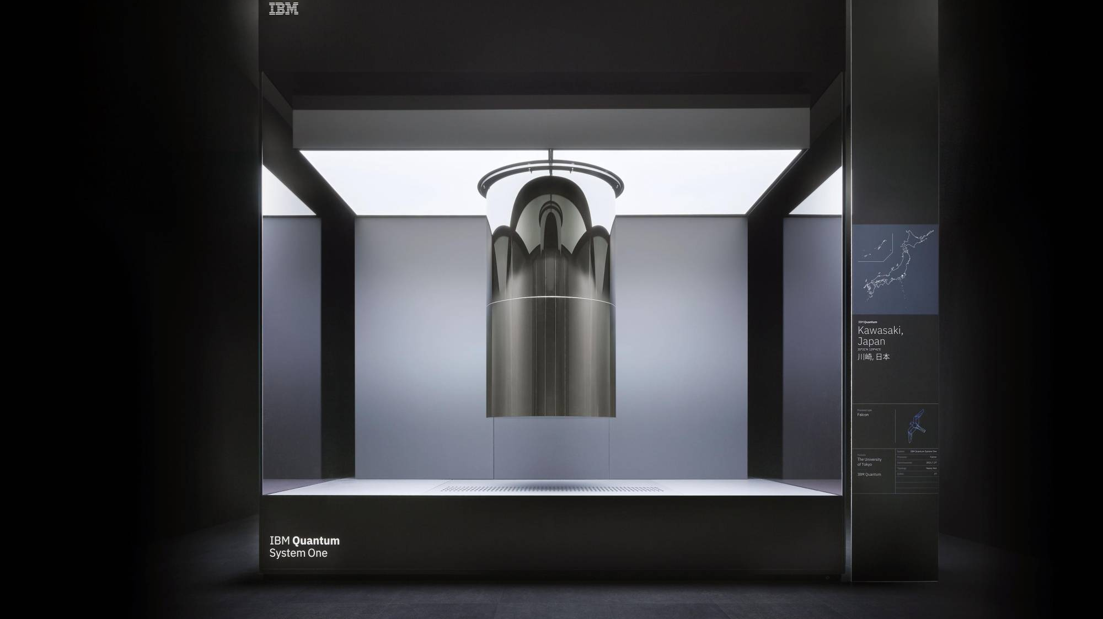
Application
The W.A.D.I.T.O.H. infrastructure can be used for a zero infrastructure setup of non contact payments using just a .wav file and microphone which is embedded in all devices nowadays, including devices which don’t connect to either RF or iternet.
It has immense military application from underwater image transmission to data transmission over handheld transceivers in extreme terrains without any radio or internet setups, this can be also carry forwarded to local authority agencies.
The other application in military is maintaining a end to end geolocation mapping of all personals , while also detecting any foreign object like people or obstacles.
Locating the PoO of artillery, mortar fire, sniper location etc, can also be tracked
Industrial powerplants which may disrupt a number of current conventional devices will also be relieved using the W.A.D.I.T.O.H. infrastructure .
Industrial tomographic imaging can also be performed in low power , high frequency setups.
The concept of ‘chirping’ and ‘listening’ has enabled a system for hotel-user authentication , it has also been enabled for any confirmation process like people boarding buses in metropolitan cities.
The project provides a great deal of alternatives to current internet and RF comms, from calling 911 in a low signal strength area, to sharing data such as text, images, videos , without delay in low power conditions.

Slide 16





Project Timeline Template
STAGE 01: 16th October 2022
Review 1
STAGE 02: 18th October 2022
STAGE 04 : 10th Nov 2022
STAGE 05: 25th Nov 2022
Correcting and improving upon the existing model, to increase simulated efficiiencies
Analyzing existing problems in conventional communication systems and forming an alternative
Importing SSTV, ARPS, UAT and HT protocols to transmit information over sound
STAGE 03: 20th October 2022
STAGE 06: 20th Dec 2022
Creating a simulation for demonstration on all stages and making it prototype ready
Additional Stage 01
Additional Stage 02
Additional Stage 03

Slide 17
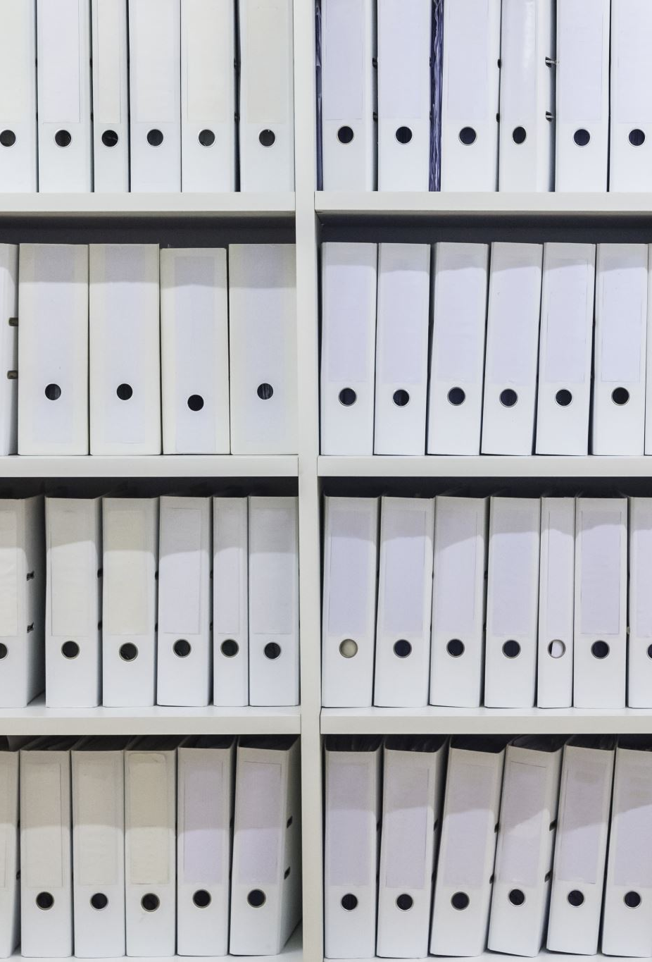
References
Qasem, Z.A.; Esmaiel, H.; Sun, H.; Wang, J.; Miao, Y.; Anwar, S. Enhanced fully generalized spatial modulation for the internet of underwater things. Sensors
Said, A.; Pearlman, W.A. A new, fast, and efficient image codec based on set partitioning in hierarchical trees. IEEE Trans. Circuits Syst. Video Technol. 1996
Jeganathan, J.; Ghrayeb, A.; Szczecinski, L. Generalized space shift keying modulation for MIMO channels. In Proceedings of the 19th International Symposium on Personal, Indoor and Mobile Radio Communications, Cannes, France, 15–18 September 2008
Mandal, A., Lopes, C.V., Givargis, T., Haghighat, A., Jurdak, R., Baldi, P., , Beep: 3D indoor positioning using audible sound, Consumer Communications and Networking Conference, 2005
William H. Press, Saul A. Teukolsky, William T. Vetterling, Brian P. Flannery, , Numerical Recipes in C: The Art of Scientific Computing, Cambridge University Press New York, NY, USA, 1992
Madhavapeddy, A.; Sharp, R.; Scott, D.; Tse, A.; , Audio networking: the forgotten wireless technology, Pervasive Computing, IEEE

